Slide 1
Rich Client
GALC Architecture

Slide 2
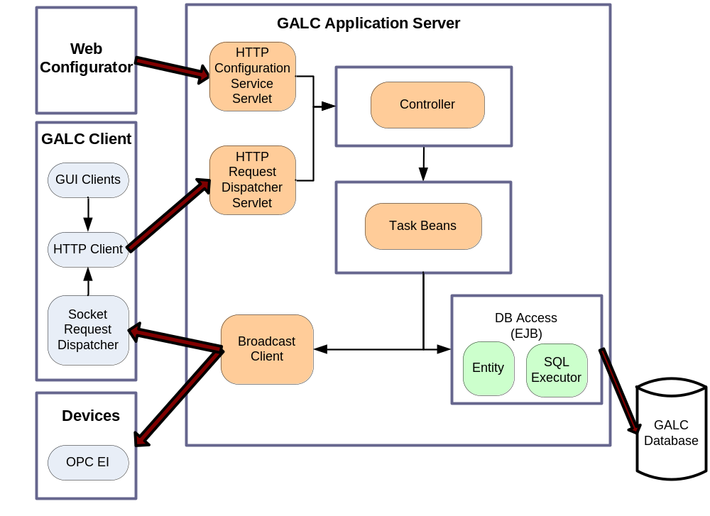
Existing GALC Architecture

Slide 3
Disadvantages of Current GALC Architecture
Server centric Approach
Most business logics are on the server, which makes server architecture complex, heavy and single point of failure (Both software and hardware)
Hard to deploy GALC build and hard to apply emergency fix
Large number of projects in GALC develop environments makes development difficult and inefficient
Client and Server have to maintain application states and keep them in sync
Huge database access operations because no server cache available

Slide 4
Implement uniform client Dao framework (Cont’d)
Service Methods (and Dao methods) are wrapped into Data Containers and a number of different ways has to be used to invoke the service methods (if else, switch case or some kind of managers)
A lot of DCToView and ViewToDC transfer object classes created , not OO friendly

Slide 5
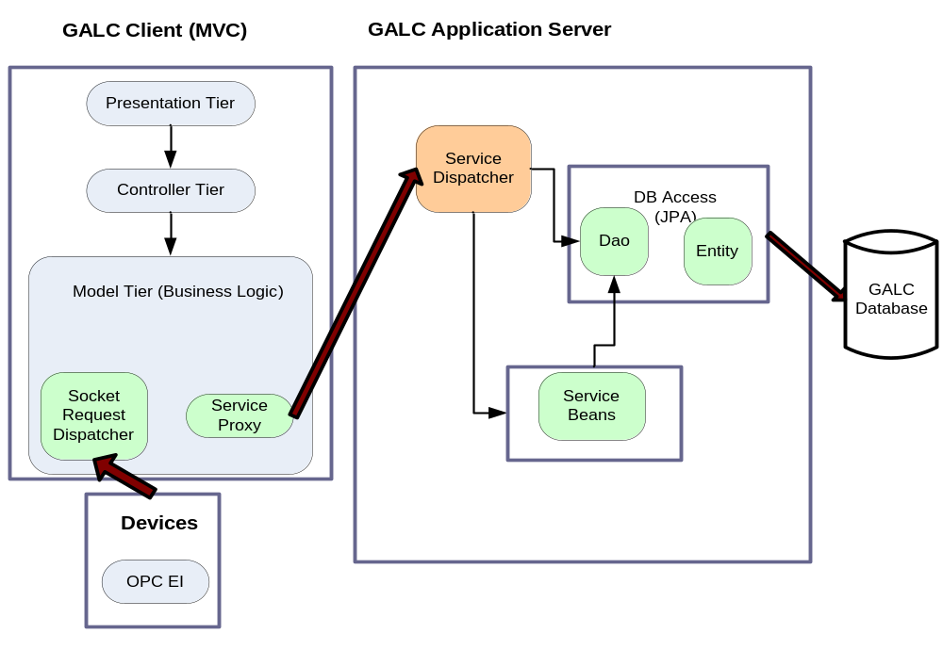
Rich Client Approach
I

Slide 6
Benefits
Client centric approach – business logic and state on client side (get them to where they should be)
Fully use client resources
Client is less dependent on server
Very light server load – hence server is less important, cheap hardware and software solution is sufficient
Center service on server very stable, only need infrequent build and update
Services on the server side are stateless

Slide 7
Benefits (Cont’d)
Easy to deploy builds on client side
Possible to deploy a quick fix to individual clients without affecting other running clients
When the server is not available, the client can save the data to the local database
Direct client Dao access eliminates server Dao façade codes and simplifies client side programming
Get object graph from one Dao service call
No Data transfer object is needed
Can fully apply OO approach on the client side to have clean codes and maximum reuse

Slide 8
How to make Rich Client possible
In Current GALC framework we can not avoid session beans and we have to rely on session bean façade to execute database operations
Implement uniform client Dao framework

Slide 9
Server in Rich Client Architecture
Database connection pool
Transaction management
Core services (Not necessarily EJB session beans)
Headless clients conveniently on server

Slide 10
Communication Model
In general, in a distributed system client needs to consume the services on the server through communication channel (request/response)
Server side needs to publish object state change to the client side (publish/subscribe)
Client
consumes
Server
Services
(Channel)
publish
(Channel)

Slide 11
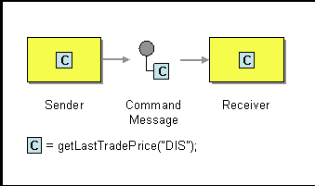
Command Message Pattern
Send command with state in a request message
Invoke a command on a remote server

Slide 12
Remote Procedural Call (RPC)
In general communication in distributed object system is RPC
Original DEC-RPC, CORBA, SOAP web service, XML-RPC, JSON-RPC
These are designed to be platform, language independent
Complex proxy, stub, marshalling, de-marshalling process
Have to define IDL, WSDL files or other forms of interface definitions

Slide 13
GALC communication Observation
GALC client and server uses same JAVA language
Java itself is cross platform
Common Interface on client and server is key

Slide 14
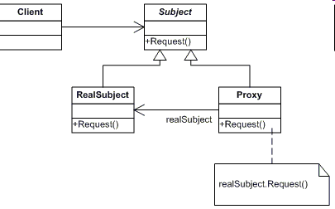
Proxy Pattern
Share service interface between client / server. This is important! It is the contract between client and server. Then you don’t have to define it in a separate IDL file
Make each service method argument typed object
Object has to be serializable

Slide 15
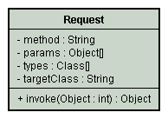
Request Message Abstraction
Every Method can be abstracted to a request object
Subclasses of request represent different types of requests
Serialize the services into requests

Slide 16
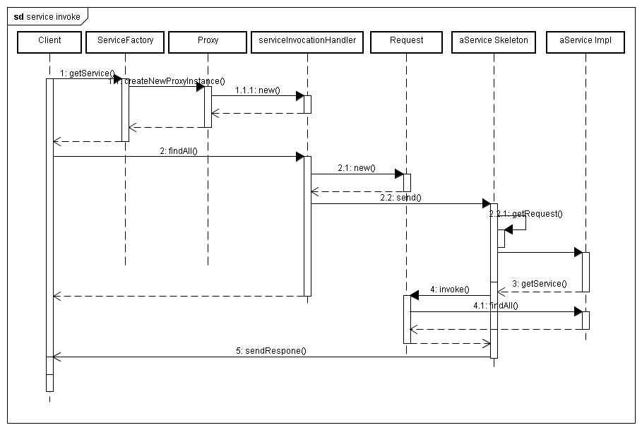
Client invokes the service

Slide 17
Client Dao Service
PlantDao plantDao = ServiceFactory.getDao(PlantDao.class);
List<Plant> plants = plantDao.findAll();
for(Plant plant: plants) {
System.out.println("Plant : " + plant.getId().getPlantName() + plant.getId().getSiteName());
for (Division division : plant.getDivisions()) {
System.out.println("Division: " + division.getDivisionId() + "name: " + division.getDivisionName());
}
}

Slide 18
Advantages of client Dao interface
Directly expose the server Dao to client, makes the database access transparent across network
No extra client code and configuration needed to access server Dao
Having generic Dao interface with Entity and key, every Dao method is typed (arguments and return values), therefore is checked at compile time

Slide 19
General services
TrackingService trackingService = ServiceFactory.getService(TrackingService .class);
trackingService.track(product, processPoint);

Slide 20
Why not add façade to Daos?
Lot of extra work to add façade to each dao
Don’t have to if we deploy daos into Spring bean container, in which transaction manager etc can be injected.
Dao is a kind of service itself

Slide 21
Base Communication Channel
Http Servlet is a good option in current J2EE environment. We can easily cluster and load balance the servlets
Spring Http Invoker is the same idea http://www.devx.com/Java/Article/32955
Benchmark: http://daniel.gredler.net/category/rpc/
Web service is also a candidate but you need to extra work like defining object maps in XML file
JMS is also an option

Slide 22
Database Access
Using JPA standard to define entity
Define relationship when appropriate

Slide 23
Basic Dao Service Interface
Using generics
public interface IDaoService<E, K> extends IService{
public E findByKey(K id);
public List<E> findAll();
public E save(E entity);
public void remove(E entity);
public List<E> findAll(Parameters parameters);
…
}

Slide 24
Individual Dao Service
public interface DeviceDao extends IDaoService<Device, String> {
public List<Device> findAllByProcessPointId(String ppId);
public List<Device> findAllByDivisionId(String divisionId);
}

Slide 25
BaseDaoImpl
public abstract class BaseDaoImpl<E,K> implements IDaoService<E,K>{
protected Class<E> entityClass;
public BaseDaoImpl() {
ParameterizedType genericSuperclass =
(ParameterizedType) getClass().getGenericSuperclass();
entityClass = (Class<E>) genericSuperclass.getActualTypeArguments()[0];
}
public E findByKey(K id) {
return entityManager.find(entityClass, id);
}
public List<E> findAll() {
return entityManager.createQuery(getFindAllSql()).getResultList();
}
}

Slide 26
Dao Implementation
public class DeviceDaoImpl extends BaseDaoImpl<Device,String>
implements DeviceDao {
public List<Device> findAllByProcessPointId(String ppId) {
return findAll(Parameters.with("ioProcessPointId", ppId));
}
public List<Device> findAllByDivisionId(String divisionId) {
return findAll(Parameters.with("divisionId", divisionId));
}
}
Dao methods are all typed with entity object
Concise code with base implementations in BaseDaoImpl class
Parameters class help to create JPQL statement

Slide 27
Enum type for entity
public enum InstalledPartStatus implements IdEnum<InstalledPartStatus> {
NC(-2), BLANK(-1), NG(0), OK(1), ACCEPT(2), REJECT(3);
private int id;
private InstalledPartStatus(int id) {
this.id = id;
}
public int getId() {
return id;
}
public static InstalledPartStatus getType(int id) {
return EnumUtil.getType(InstalledPartStatus.class, id);
}
}
public class InstalledPart extends AuditEntry {
public InstalledPartStatus getInstalledPartStatus( ) {
return InstalledPartStatus.getType(installedPartStatusId);
}
public void setInstalledPartStatus(InstalledPartStatus status) {
this.installedPartStatusId = status.getId();
}
}
Use Enum
InstalledPartStatus.OK, InstalledPartStatus.NG

Slide 28
Trim String for entity
JPA does not trim string for CHAR type
Messy code if trim in getter or in the application code
Use JPA @PostLoad
@Entity
@Table(name = "GAL243TBX")
public class ApplicationTask{
@Column(name = "JNDI_NAME")
private String jndiName;
@PostLoad
public void postLoad() {
id.postLoad();
this.jndiName = StringUtils.trim(jndiName);
this.argument = StringUtils.trim(argument);
}
}

Slide 29
Subscribe and Publish
New Tables to define Notification,Notification_Provider and Notification_Subscriber
Notification provider can be on server side or on a client side
Client side uses a backdoor server socket to receive notifications
Multiple provider can send the same notification
Multiple clients can subscribe and receives multiple notifications from multiple providers
Providers maintains subscription list, if it fails to publish to a subscribers, subscriber is removed from the list
Client Subscriber sends the heartbeat to the providers. If the provider is down and comes back later on, it can automatically resubscribe. This gives the flexibility of restarting the server and client anytime

Slide 30
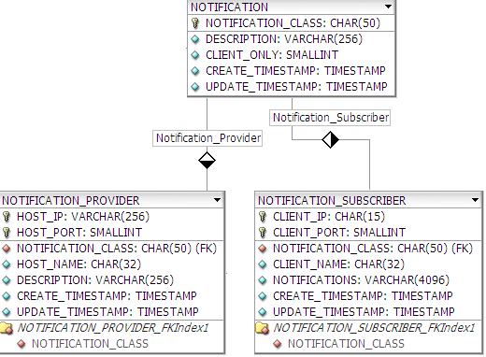
Notification ERD

Slide 31
Define Notification Service
public interface ILotControlRuleNotification extends INotificationService{
public void updated(LotControlRule lotControlRule);
public void remove(LotControlRule entity);
}

Slide 32
Publish Notification
import static com.honda.galc.service.ServiceFactory.getNotificationService;
public class LotControlRuleDaoImpl extends BaseDaoImpl<LotControlRule, LotControlRuleId> implements LotControlRuleDao{
@Transactional
public LotControlRule save(LotControlRule entity) {
LotControlRule updated= super.save(entity);
getNotificationService(ILotControlRuleNotification.class)
.updated(updated);
return updated;
}
}

Slide 33
Subscribe and Consume Notification
public class LotControlMainWindow implements ILotControlRuleNotification,
IPropertyNotification {
private void initialize(ApplicationContext appContext) {
appContext.getNotificationSubscriber().subscribe("ILotControlRuleNotification",this);
appContext.getNotificationSubscriber().subscribe("IPropertyNotification",this);
}
public void updated(LotControlRule lotControlRule) {
getLogger().debug("Received notification of lot control rule update: " +
lotControlRule.getId().getProcessPointId() + ":" + lotControlRule.getId().getPartName());
clientContext.update(lotControlRule);
}
public void remove(LotControlRule lotControlRule) {
getLogger().debug("Received notification of lot control rule delete: " +
lotControlRule.getId().getProcessPointId() + ":" +
lotControlRule.getId().getPartName());
clientContext.remove(lotControlRule);
}
}

Slide 34
Property Service
Enhanced the current GALC property service
Property Bean
Property Inheritance

Slide 35
Property Bean
@PropertyBean(componentId ="Default_LotControl")
public interface LotControlPropertyBean extends IProperty{
  boolean isCheckProcessedProduct();
  boolean isSendStatusToPlc();
  boolean isHasTorqueGun();
  boolean isCheckExpectedProductId();
  //default observers
  String getAudioObserver();
  String getDeviceObserver();
  String getPersistenceObserver();
  //default processors
  String getProductIdProcessor();
  String getPartSnProcessor();
  String getTorqueProcessor();
  //default device Id
  String getStatusDeviceId();
  @PropertyBeanAttribute
  public Map<String, String> getObservers();
}

Slide 36
Property Inheritance
public interface TerminalPropertyBean
extends DevicePropertyBean, AudioPropertyBean,
LotControlPropertyBean, ImagePropertyBean,
ViewManagerPropertyBean, FSMPropertyBean,
DataSyncProperty{
}
public interface DefaultViewProperty
extends DefaultViewPropertyBean,
ImagePropertyBean,
ViewProperty {
}

Slide 37
Using Property Service
TerminalPropertyBean property = PropertyService
.getPropertyBean(TerminalPropertyBean.class, terminalId);
property.isCheckExpectedProductId();

Slide 38
GALC Logging
Standalone Log Server
Messages can be logged from both server and client side to the log server
Log Server logs messages to the center log file, tivoli log file and individual log files for each client (More detailed information)
Using Log4J on client side
Logger automatically switches connection between primary and secondary log server

Slide 39
GALC Logging –Cont’d
If both primary and secondary log server are down, log into the local file
Each client ‘s log level can be changed dynamically to support better troubleshooting
Logging can be used in both GALC server and client side

Slide 40
Using Logger
import static com.honda.galc.common.logging.Logger.getLogger;
getLogger().debug(“message”);
getLogger().info();
getLogger().warn();
getLogger().error();
getLogger().emergency();
getLogger().error(exception, “message”)
When logging exceptions, log server will log the detailed stack trace
Into the individual client log file

Slide 41
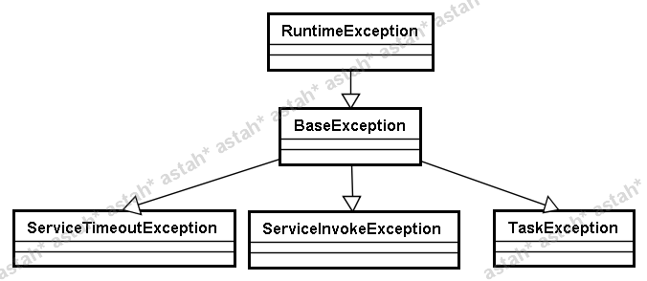
Exception Handling
Exception hierarchy
Using unchecked exception to avoid unnecessary catch throw
Catch all exceptions in HttpServiceHandler servlet
Transfer GALC defined exception directly from server to client
Translate non GALC defined exception such as JPA, Spring exception to ServiceInvokeException and log full stack trace to log server for troubleshooting

Slide 42
A few thought about client framework
Using MVC (MVP) pattern
Rich Domain Object
Using FSM (Finite State Machine) pattern to control application( In lot control)
Separate business logic from view
Reusable View components (event model)

